Slide 1
Week 7
Alexey V. Zimin
JHU BME 580.417/707

Slide 2
Assembly polishing
Contig sequence produced by assemblers contains errors, especially if ONT data was used: AGACATAGACGAAGACATAGGTA
We can fix errors by aligning low error reads (Illumina or HiFi) to the assembly: AGACATAGACGA*AGACATAGGTA AGACACAG CACAGACGATAGA ACAGACGATAGACGTAGGT ATAGACGTAGGT AGACCTAGGTA ACGTAGGTA
This is called polishing

Slide 3
Assembly polishing
Caution on polishing: if the reads were not used for the original assembly, they may come from regions that are missing from the assembly, but similar to another region present in the assembly
In this case read aligner may align the reads to the wrong place
Polishing programs try to deal with these cases by looking for reads that agree with the assembly, but in low-coverage regions there may be not enough of them

Slide 4
Evaluating genome assemblies: size
Most eukaryotic genomes are diploid or polyploid:
One chromosome from each parent
Estimated genome size is typically counting each chromosome ONCE
Human genome size is ~3.2G bp
Traditional pseudo-haploid genome assembly is a mosaic of two haplotypes
Total sequence in the assembly:
<< Estimated genome size: incomplete assembly, possibly due to insufficient sequencing depth, collapsed repeats, elimination of short contigs
>>Estimated genome size: redundant assembly, possibly due to extra haplotype variants for heterozygous diploid/polyploid genomes

Slide 5
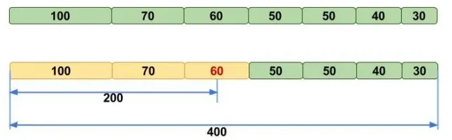
Evaluating genome assemblies: N50
N50 metric: the length of the shortest contig (scaffold) for which longer or equal length contigs (scaffolds) contain at least 50% of the total assembly
NG50 -- N50 that uses estimated genome size instead of assembly size
Image credit: molecularecologist.com

Slide 6
Note about N50
N50 may be unstable when there are only few big contigs in the assembly. For example, for 100Kb genome:
55,25,20 yields N50 of 55
40,35,25 yields N50 of 35
When comparing two assemblies N50, one must use the same assembly size. Using smaller assembly size boosts N50:
Contigs: 70, 60, 50, 30, 20, 10, 10,10, 5, 5, 5, 5 sum=280
N50(G=280)=50, N50(G=260)=60
This is why NG50 is more “fair” when comparing two assemblies of the same organism

Slide 7
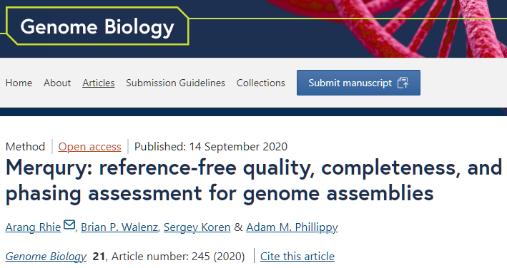
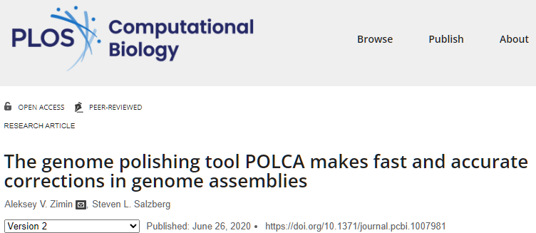
Evaluating genome assemblies: error rate
Consensus error rate can be estimated by aligning accurate reads from the same organism to the assembly
Can use the original reads
Suitable reads: Illumina and PacBio HiFi
Can use alignment-based approach (POLCA) or k-mer based approach (Merqury)

Slide 8
Lab #4: Build K-unitigs from K-mers
Lab #4: Due Friday October 24. The goal for Lab #4 is to write code that parses reads in fastq file, counts canonical K-mers for a given K, and then builds K-unitigs – unique non branching paths of K-mers in a K-mer graph. K-unitigs are genomic sequences. All K-mers in the reads must be present in K-unitigs. Each K-mer of size K must be in only one K-unitig.
Reads are provided in autograder as “read1.fq”. You can assume that this file is in your current directory. Reads are also available on github for testing: https://github.com/alekseyzimin/BME-Algorithms-for-Analysis-of-Genomic-Data/raw/refs/heads/main/read1.fq
Write the following functions in python:
(g:10/u:10) reverse_complement(seq) – returns reverse complement of sequence seq
(g:10/u:10) canonical_kmer(kmer) – returns canonical version of the k-mer kmer using lexicographic order
(g:10/u:20) count_canonical_kmers(file.fastq,k) – reads genome sequences from file.fastq, returns dictionary kmer_counts[kmer]=count for K-mer size k
(g:10/u:20) compute_n50(sequences) -- returns N50 of sequences in the input array sequences
(g:40/u:40) build_unitigs(kmer_counts) – returns array of k-unitig sequences, argument is dictionary kmer_counts produced by count_canonical_kmers
Graduate section only(g:20): run compute_n50(build_unitigs(count_canonical_kmers(fastq_path,k))) code varying K-mer size between 15 and 90, and submit a plot of how K-unitigs N50 varies with K. At which K value the N50(K) is the largest? Add the value in a text box to the plot.

Slide 9
K-unitigs
K-unitigs are uniquely assemble-able paths of K-mers connected with K-1 exact overlaps
Paths must not contain any branches in forward or reverse direction
Pick a canonical K-mer, check if it has been used in a path before, and if not, extend uniquely forward and backward checking for branches
Stop extension if a forward or backward branch detected

Slide 10
ATG 1
TGA TCA 1
ATC 1
(a,,,)TG(a,,,) -> ATGA(a,c,g,t)
(a,c,g,t)ATG
ATC
For b in [ACGT]:
Continuation_f=suffix+b
Continuation_b=b+suffix
If(canonical_kmer(

Slide 11
Forward branch
Start with AGACA check continuation to the right. What are the possible continuations of GACA ? GACAC AGACA GACAG none A
This is a “forward branch”. K-1 mer on the right GACA has two possible extensions. Do not extend.

Slide 12
K-mer graph
Can we extend K-mer GACAC to the left even if continuation is unique? GACAC AGACA C no GACAG
G no T no A
GACAC cannot be extended to the left because of a “backward branch”, since the continuation of GACA to the right is not unique

Slide 13
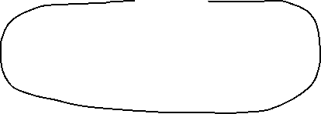
K-unitigs
This graph contains five K-unitigs (black lines)
K-1 overlap
K-1 overlap

Slide 14
Genome assemblers
Hifiasm -- for PacBio HiFi or ONT, can use HiC to resolve haplotypes, uses string graph, error corrects reads uses perfect long overlaps
Flye -- for Oxford Nanopore (and PacBio hifi), uses string graph
Verkko – can produce T2T assemblies uses PacBio HiFi+ONT data, high coverage requirements
MaSuRCA -- for hybrid data sets – uses both K-mer graph (super-reads) and OLC/String graph
YaHS – for scaffolding assemblies with HiC reads

Slide 15
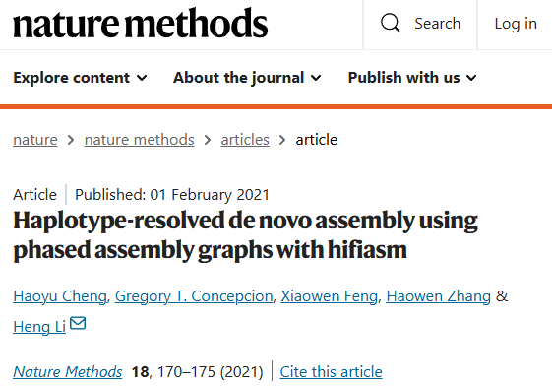
Hifiasm
Used for PacBio HiFi data or the latest (R10.4) ONT data (beta)
Can do haplotype-resolved assemblies with HiC data
Fast and accurate
Error corrects reads, uses string graph with exact overlaps
Can produce assemblies with T2T chromosomes
Outputs assembly in graph format (.gfa)
Use gfatools to output fasta:
gfatools gfa2fa in.gfa > out.fa

Slide 16
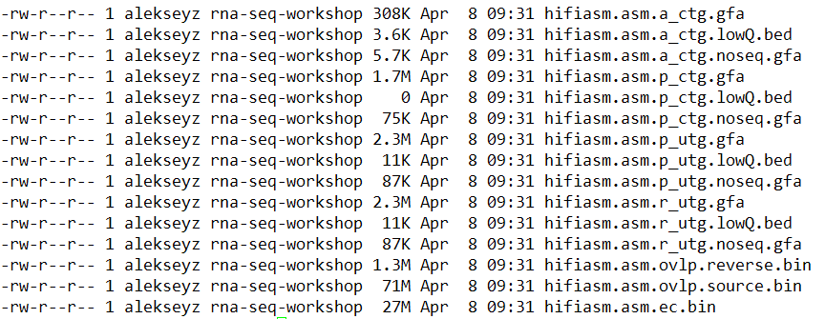
Hifiasm
Outputs:

Slide 17
Hifiasm
Overlaps and error corrected reads; computing these files takes the most time. You can keep them to quickly rerun with different parameters.

Slide 18
Hifiasm
Raw uniquely assemble-able contigs (unitigs), with small bubbles

Slide 19
Hifiasm
Primary uniquely assemble-able contigs (unitigs), without small bubbles

Slide 20
Hifiasm
Primary contigs

Slide 21
Hifiasm
Alternative contigs

Slide 22
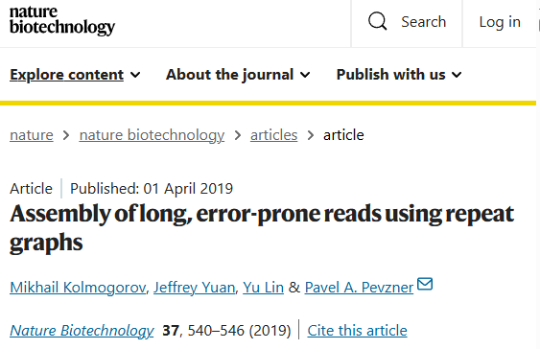
Flye
Assembly of Pacbio CLR/HiFi, ONT reads
Not haplotype-aware
Uses string graph
Can assemble metagenomic data sets
Slower than Hifiasm
Assemblies of high-error reads (PacBio CLR or ONT) need to be polished

Slide 23
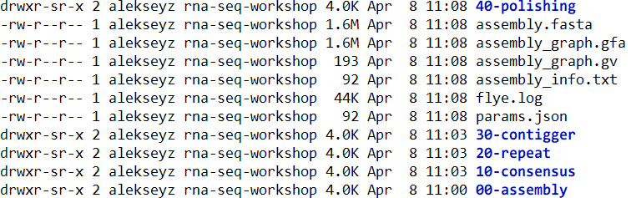
Flye
Outputs:
Assembled scaffolds
Assembly log, information about the assembly

Slide 24
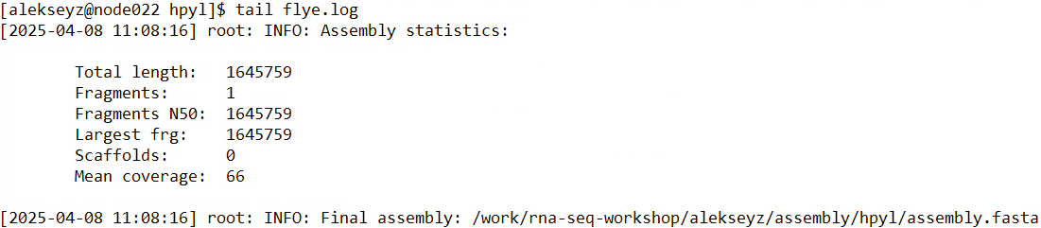
Flye
Outputs:

Slide 25
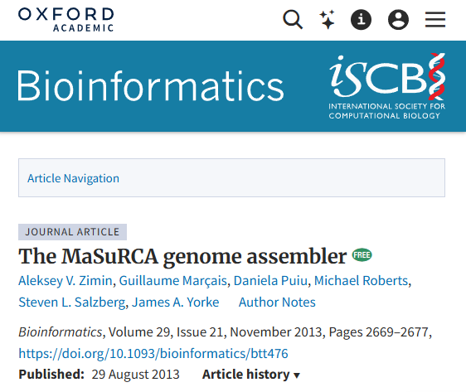
MaSuRCA
Originally designed for short Illumina reads
Enables hybrid assembly, ONT + Illumina, or PacBio CLR + Illumina
Requires Illumina data
Can assemble mega-genomes (20Gbp +)

Slide 26
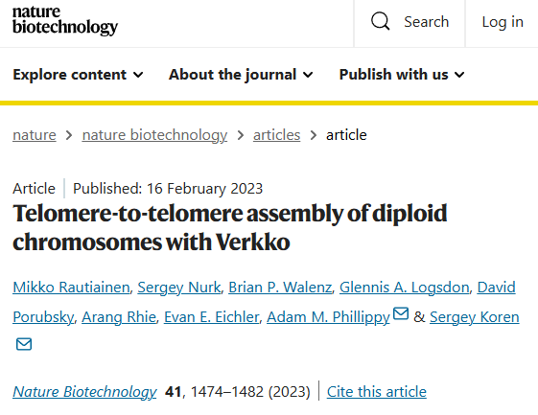
Verkko
Assembly of hybrid PacBio HiFi/ONT ultralong data
Can use HiC data for haplotype resolution/scaffolding
Builds assembly graph from error corrected HiFi reads, resolves with ONT ultralongs and HiC
High coverage requirements: ~50x PacBio HiFi, ~50x ONT ultralongs
Can produce assemblies where many chromosomes are T2T

Slide 27
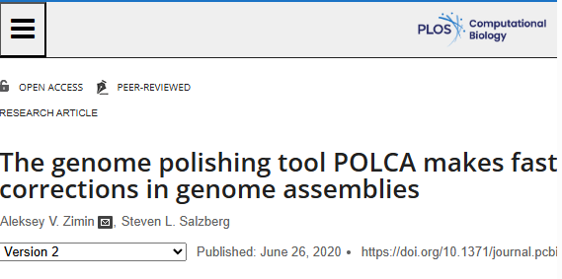
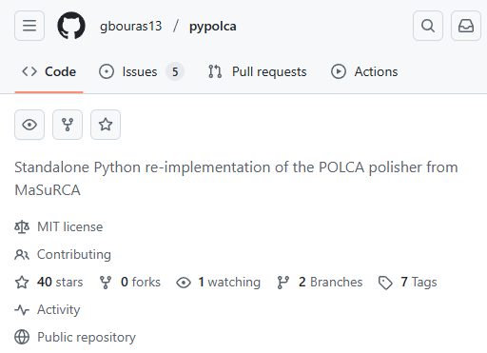
MaSuRCA - POLCA
Polishing tool to fix errors in contigs
Can be used for variant calling (convenient!)
Evaluates contig sequence quality
Distributed with MaSuRCA assembler
Has been re-implemented in Python as pypolca

Slide 28
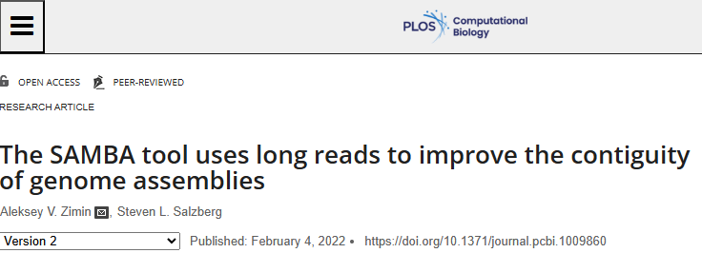
MaSuRCA - SAMBA
Scaffolding tool to improve contig sizes with long reads (ONT/PacBio)
Can be used to improve assemblies with additional data without complete re-assembly
Can be used to close gaps in scaffolds

Slide 29
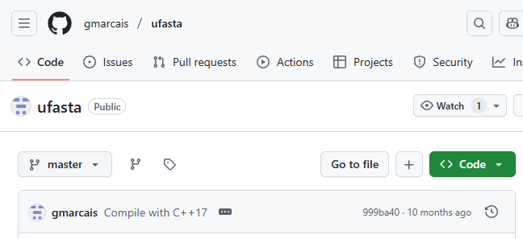
MaSuRCA - ufasta
Multi-purpose tool to work with fasta files
Extract records by name, random sample
Reverse complement
Format
Compute statistics
N50
Averages
E-size
Count

Slide 30
MaSuRCA - ufasta
ufasta can take input from file or pipe
ufasta usage:
Compute N50, total sequence, fragment counts: ufasta n50 -a, –NXX, –S, –C
Extract sequences: ufasta extract -f names.txt, –n single_name, -v
Format file: ufasta format
Make every sequence int one line: ufasta one
Reverse complement: ufasta rc

Slide 31
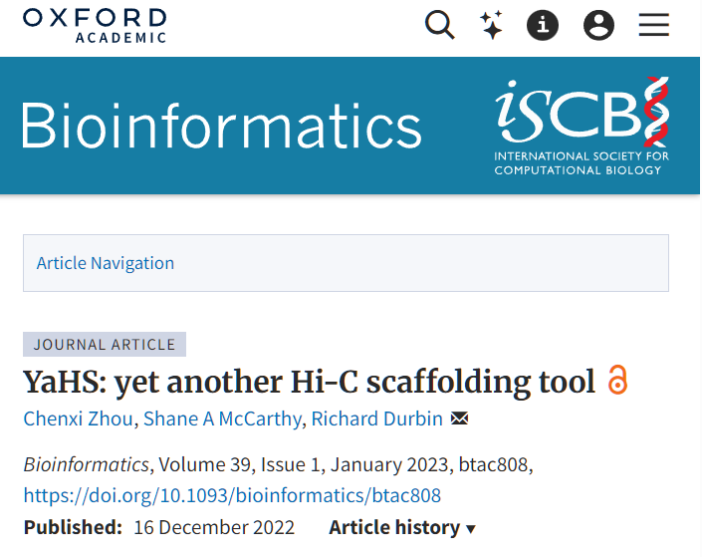
YAHS scaffolder
Uses HiC data to scaffold contigs into chromosome-sized scaffolds
Requires very contiguous assembly (N50 contig > 500K bp)
I recommend using modified fork from my github: https://github.com/alekseyzimin/yahs

Slide 32
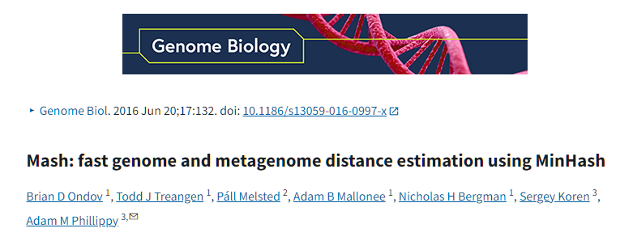
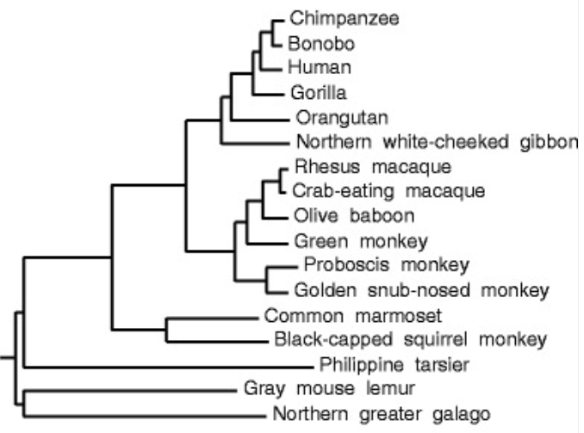
Similarity of genomes
There are many assembled genomes available
Can we figure out how similar two genomes are?
Can use alignment, but what if we have 1000’s of genomes?
Can use Jaccard similarity index!

Slide 33
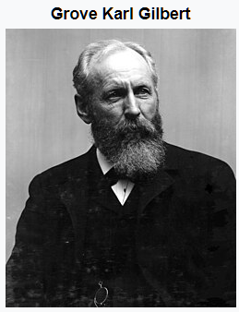
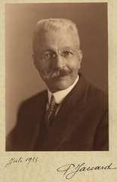
Jaccard similarity index
The Jaccard index is a statistic used for gauging the similarity and diversity of sample sets. It is defined in general taking the ratio of two sizes (areas or volumes), the intersection size divided by the union size, also called intersection over union (IoU).
It was developed by Grove Karl Gilbert in 1884 as his ratio of verification and now is often called the critical success index in meteorology.
It was later developed independently by Paul Jaccard, originally giving the French name coefficient de communauté (coefficient of community)
Images credit: wikipedia

Slide 34
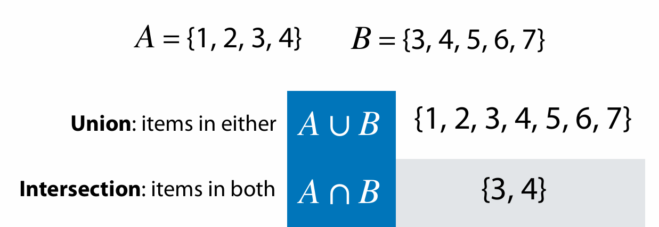
Sets
Adapted from Ben Langmead https://www.cs.jhu.edu/~langmea/resources/lecture_notes/140_similarity_pub.pdf

Slide 35
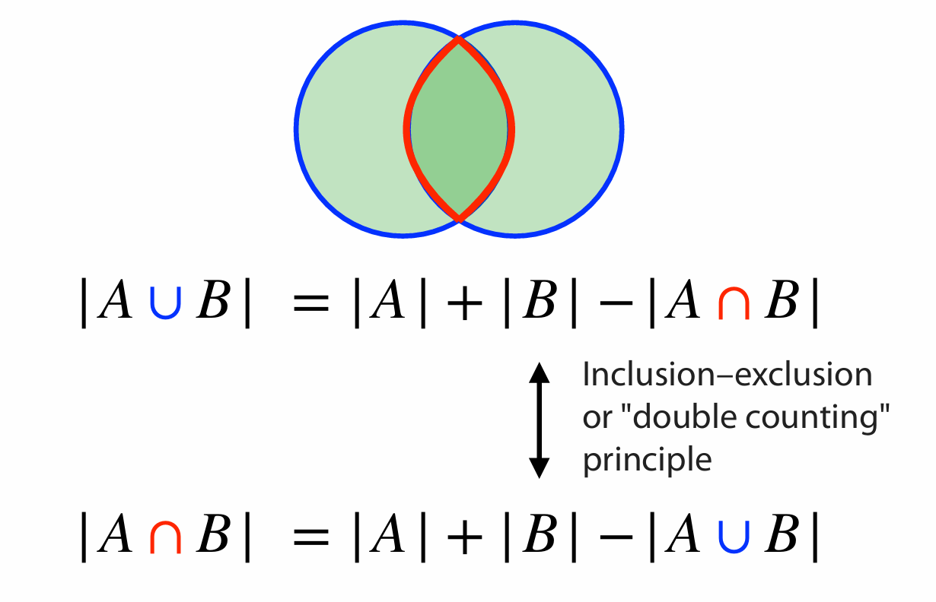
Sets
Adapted from Ben Langmead https://www.cs.jhu.edu/~langmea/resources/lecture_notes/140_similarity_pub.pdf

Slide 36
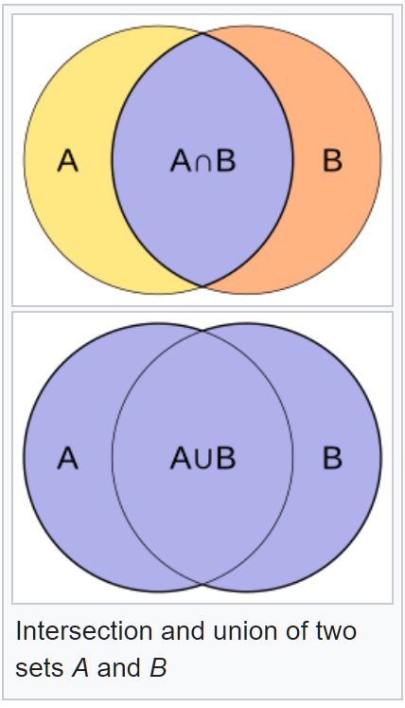


Jaccard index (or coefficient)
The Jaccard index is a statistic used for gauging the similarity and diversity of sample sets. It is defined as the intersection size divided by the union size, also called intersection over union (IoU):
$$J\left(A,B\right)=\frac{\left|A\bigcap{B} \right|}{\left|A\bigcup{B} \right|}$$

Slide 37
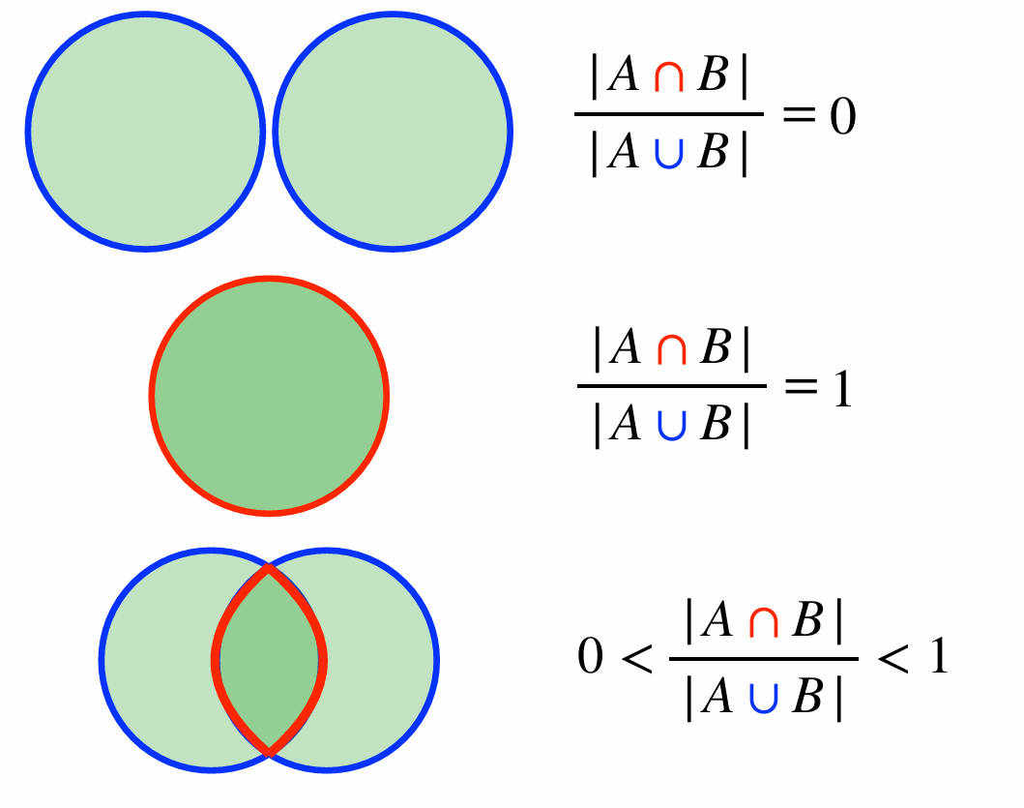
Jaccard coefficient
Adapted from Ben Langmead https://www.cs.jhu.edu/~langmea/resources/lecture_notes/140_similarity_pub.pdf

Slide 38
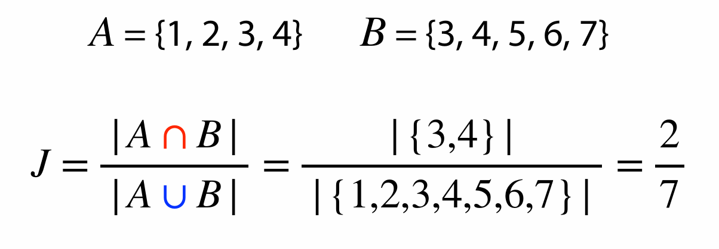
Jaccard coefficient
Adapted from Ben Langmead https://www.cs.jhu.edu/~langmea/resources/lecture_notes/140_similarity_pub.pdf

Slide 39

Jaccard index for genome similarity/alignment
Have genomes A and B
Get all canonical K-mers from A and B
Jaccard similarity can be computed from distinct K-mer sets in A and B
Hash each K-mer to an integer h(k)
K-mer sets could be large
Can use sets of distinct minimizers M(A) and M(B):
$$J(A,B)=\frac{\left|M(A)\bigcap{M(B)} \right|}{\left|M(A)\bigcup{M(B)} \right|}$$

Slide 40
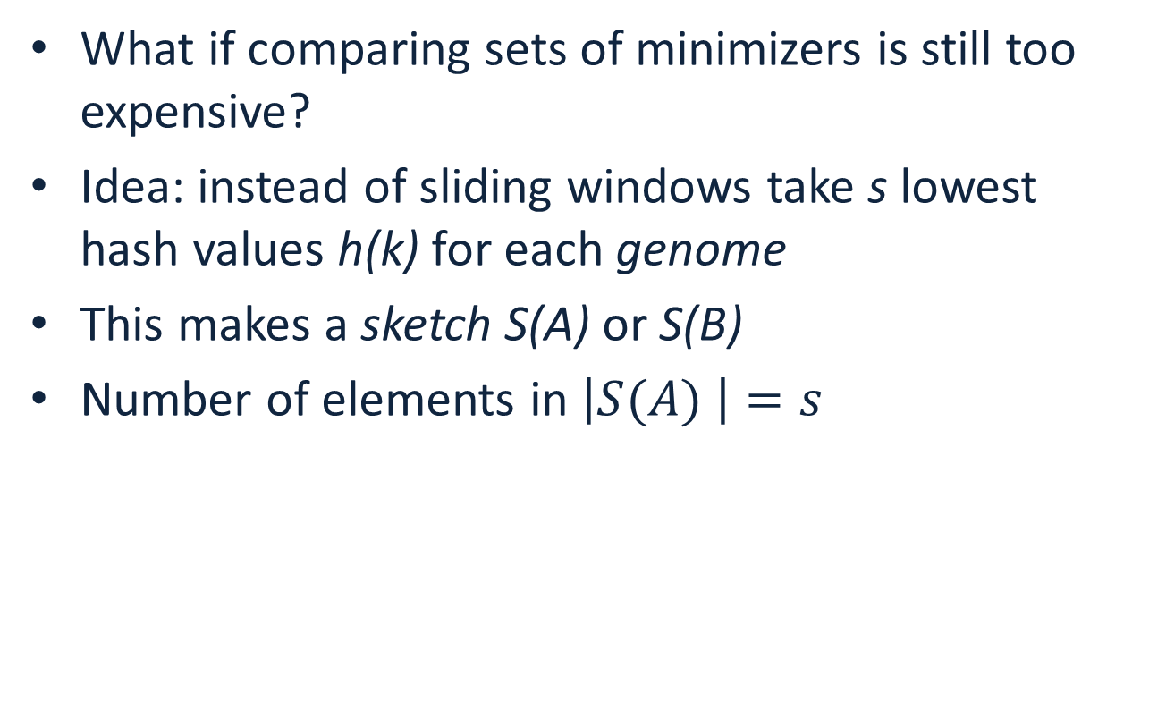
Jaccard index for genome similarity/alignment
What if comparing sets of minimizers is still too expensive?
Idea: instead of sliding windows take s lowest hash values h(k) for each genome
This makes a sketch S(A) or S(B)
Number of elements in $\left|S(A) \right|=s$
$$J(A,B)≈\frac{\left|S(A)\bigcap{S(B)}\right|}{\left|S(A)\bigcup{S(B)} \right|}≈\frac{\left|S(A\bigcup{B)}\bigcap{S(A)\bigcap{S(B)}}\right|}{\left|S(A\bigcup{B)}\right|}$$

Slide 41
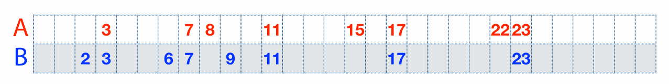
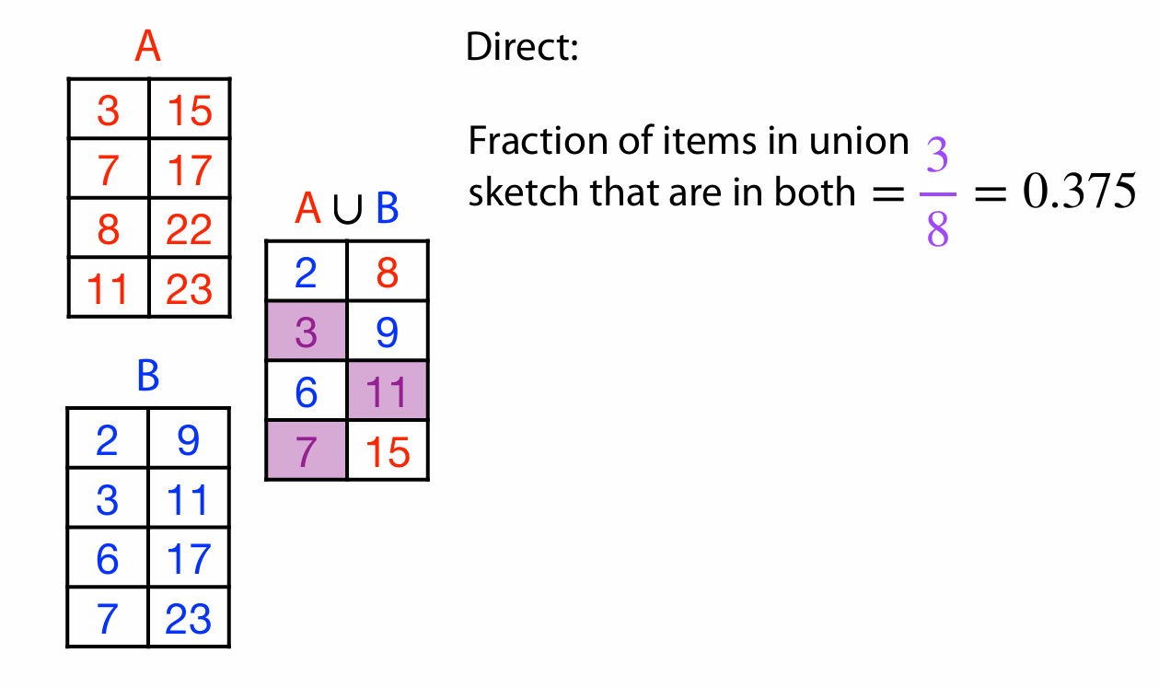
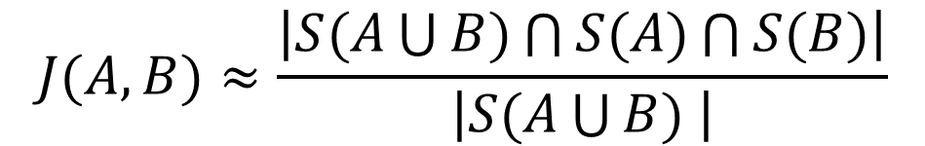



Another example
$$S(A)$$
$$S(A\bigcup{B)}$$
$$S(B)$$
$$J(A,B)≈\frac{\left|S(A\bigcup{B)\bigcap{S(A)}\bigcap{S(B)}}\right|}{\left|S(A\bigcup{B) }\right|}$$

Slide 42
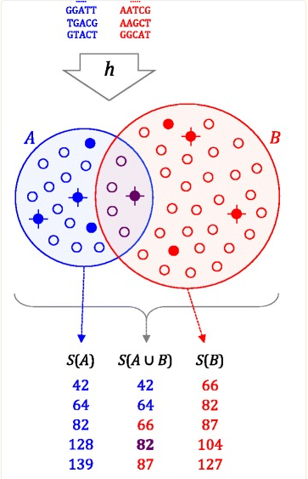

Genome distance estimation using MinHash
Reduce each genome to a MinHash(G), a set of s integers (typically 500-10000)
Compare MinHashes (sort)
$$J(A,B)≈\frac{\left|S(A\bigcup{B)\bigcap{S(A)}\bigcap{S(B)}}\right|}{\left|S(A\bigcup{B) }\right|}$$

Slide 43
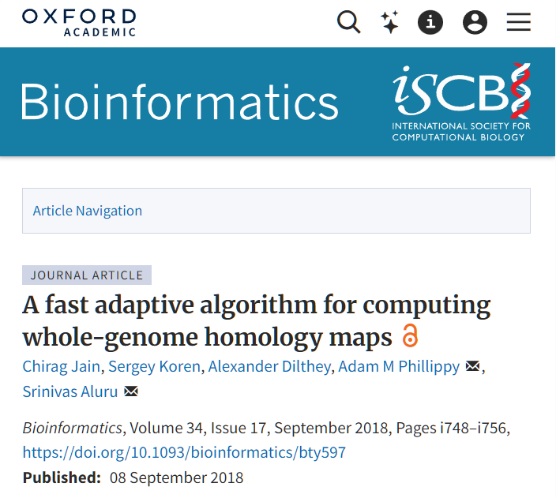
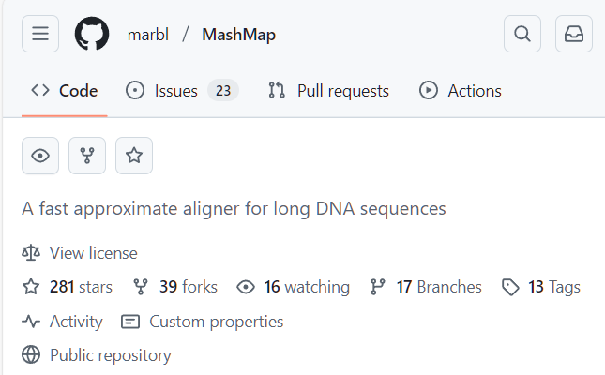
Computing approximate alignments with MinHash
Can store genome positions of k-mers in the MinHash
Compute approximate alignments as clusters of shared k-mers
Requires bigger MinHash size s
Implemented in MashMap software

Slide 44
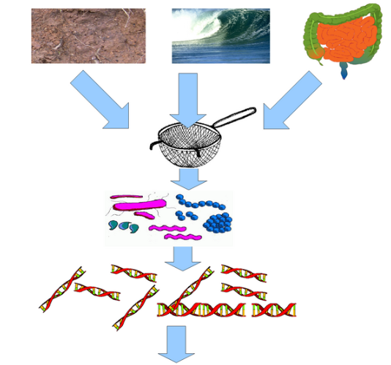

Metagenomic data analysis
In a typical genome project you want to sequence DNA from a single organism
Metagenomic data is sequenced from a sample intentionally containing many species (many of them unknown)
Important for studying composition of microorganisms (bacteria of fungus), diagnostics of diseases

Slide 45
Characteristics of metagenomic data
Typically short reads (Illumina)
Number of species: unknown
Coverage of each species: unknown
Assembly possible? Maybe, but similar species can assemble together forming chimeric contigs
Preferred mode of analysis: K-mers

Slide 46
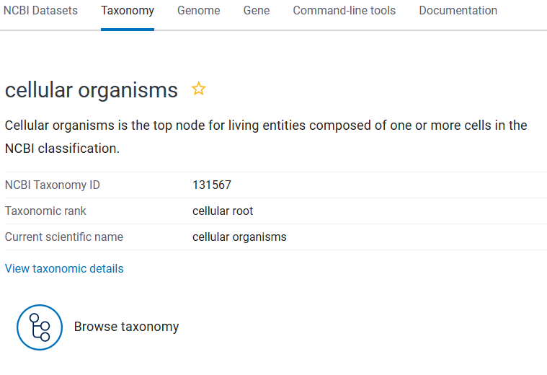
NCBI Taxonomy
The Taxonomy Database is a curated classification and nomenclature for all organisms in the public sequence databases.
This currently represents about 10% of the described species of life on the planet.
All known species are part of NCBI Taxonomy tree. Each node on the tree has a numerical ID

Slide 47
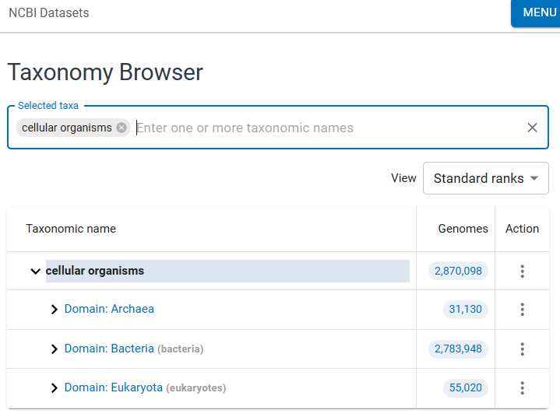
NCBI Taxonomy Browser
By browsing the taxonomy tree one can find all known species, their ID and known evolutionary relationships
DEMO

Slide 48
Analysis of metagenomic data
High resolution: KrakenUniq:
Build database of all k-mers in a set of species to be classified
Attach Taxonomic ID to each K-mer
Use the lowest common ancestor’s ID
Examine all k-mers in reads from metagenomic sample
Determine what Tax IDs are present
Databases are BIG!

Slide 49
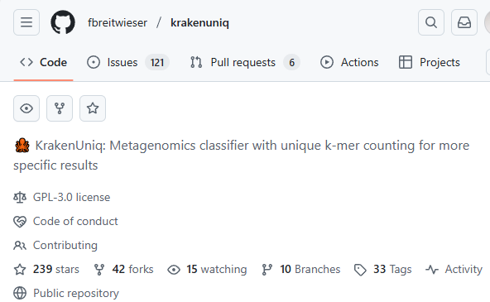
Analysis of metagenomic data
High resolution: KrakenUniq:
Build database of all k-mers in a set of species to be classified
Attach Taxonomic ID to each K-mer
Use the lowest common ancestor’s ID
Examine all k-mers in reads from metagenomic sample
Determine what Tax IDs are present
Databases are BIG!

Slide 50
Analysis of metagenomic data
WARNING! Contamination!
Species detected != It is in the sample
Lab contamination
Illumina sequencing chemicals have contaminants in them
Sample collection contamination
Can run control sample to eliminate contamination

Slide 51
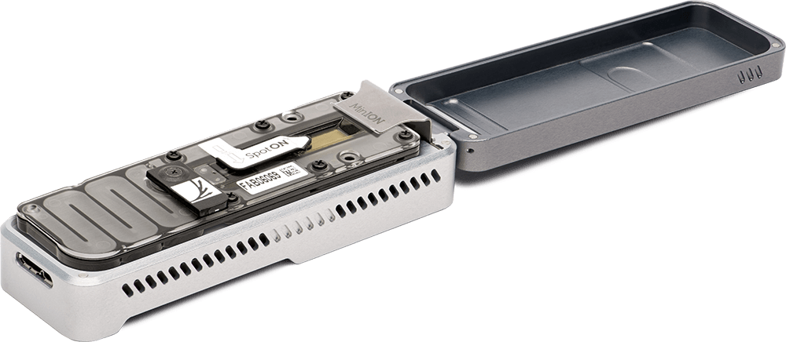
Long-read metagenomics
Long read sequencing is getting cheaper -> can use them for metagenomic samples
ONT MinION is portable – can take it into the field
Each read yields more K-mers
Create database of sketches or minimizers in genomes
Use minimizers with large window size – number or minimizers proportional to each genome size, or
Use fixed size sketches
Assign the Tax ID of the lowest common ancestor to each K-mer

Slide 52
Making sense of genomic sequence
We assembled the genome – what is next?
We can identify functionally important elements (subsequences):
Genes
Protein coding regions
Regulatory elements
This is called genome annotation
Genome annotation provides coordinates (start, stop and strand) and identifies function of functional elements in the genomic sequence

Slide 53
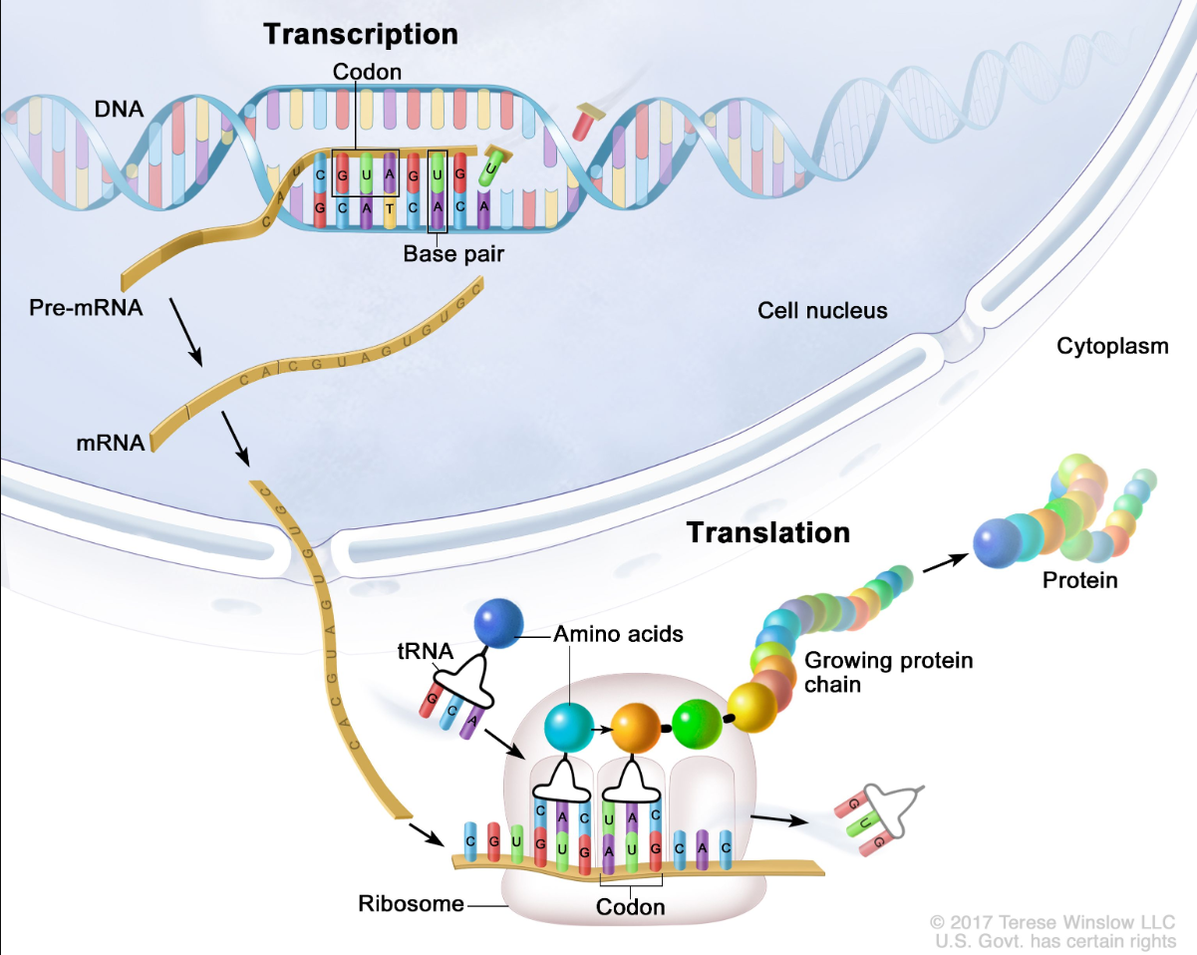
How transcription + translation works?
Transcription and translation are processes a cell uses to make all proteins the organism needs to function from information stored in the sequence of bases in DNA
Pre-mRNA has introns
mRNA has introns spliced out
Transcript is mRNA with U’s replaced by T’s
Notes:
Transcription and translation are processes a cell uses to make all proteins the body needs to function from information stored in the sequence of bases in DNA. The four bases (C, A, T/U, and G in the figure) are the building blocks of DNA and RNA. During transcription, a piece of DNA that codes for a specific gene is copied into messenger RNA (mRNA) in the nucleus of the cell. The mRNA then carries the genetic information from the DNA to the cytoplasm, where translation occurs. During translation, proteins are made using the information stored in the mRNA sequence. The mRNA attaches to a structure called a ribosome that can read the genetic information. As the mRNA passes through the ribosome, another type of RNA called transfer RNA (tRNA) carries a protein building block called an amino acid to the ribosome. The tRNA carrying the amino acid binds to a matching sequence in the mRNA. As each tRNA binds to the mRNA strand, the amino acid it carried joins with the other amino acids to form a chain of amino acids. Once all of the amino acids coded for in the piece of mRNA have been linked, the completed protein is released from the ribosome.

Slide 54
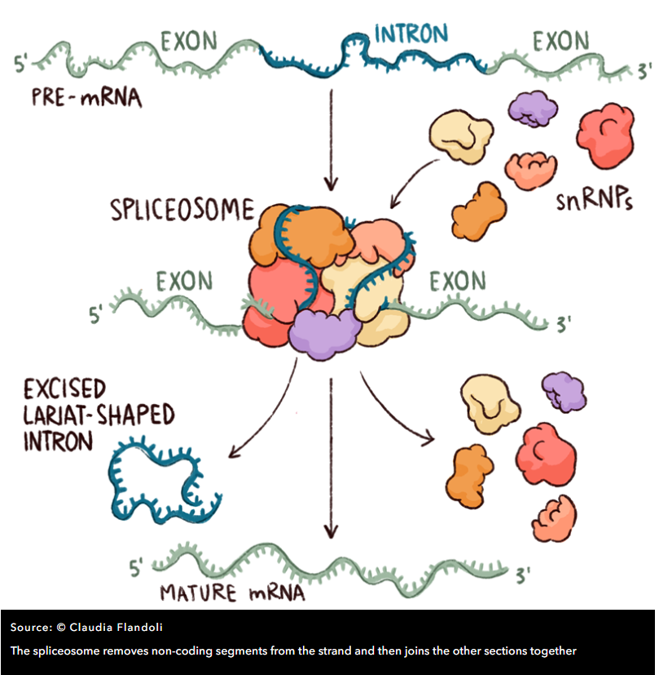
Splicing
Spliceosome includes five so-called ‘small nuclear ribonucleoproteins’ (snRNPs, often pronounced ‘snurps’) and numerous associated proteins.
The snRNPs contain RNA that is rich in Uracil, the RNA base that replaces DNA’s Thymine, and they are named – perhaps unimaginatively – U1, U2, U4, U5 and U6
Spliceosome determines the start and end of an intron by detecting DNA patterns around donor (typically GT) and acceptor (typically AG) sites

Slide 55
Poly-A tail
The poly-A tail is a long chain of Adenine nucleotides that is added to a messenger RNA (mRNA) molecule during RNA processing to increase the stability of the molecule
Processing of the 3' end adds a poly-A tail to the RNA molecule that is between 100 and 250 A’a long
Poly-A tail allows the mature messenger RNA molecule to be exported from the nucleus and translated into a protein by ribosomes in the cytoplasm

Slide 56
How transcripts are obtained
Two methods
Ribosome depletion (ribo-zero)
Poly-A capture
Dominant method is Poly-A capture (EST, RNA-Seq, Iso-Seq,ONT sequencing)
Reads mature transcripts with introns spliced out
Requires fresh good quality RNA
Good for transcriptome assembly
Ribo-zero can be used for degraded RNA
OK for quantification
Bad for transcriptome assembly

Slide 57
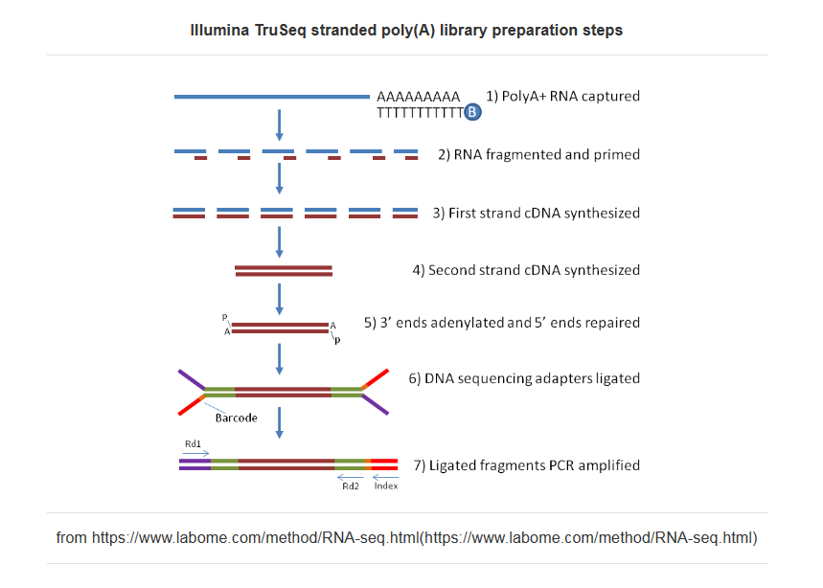
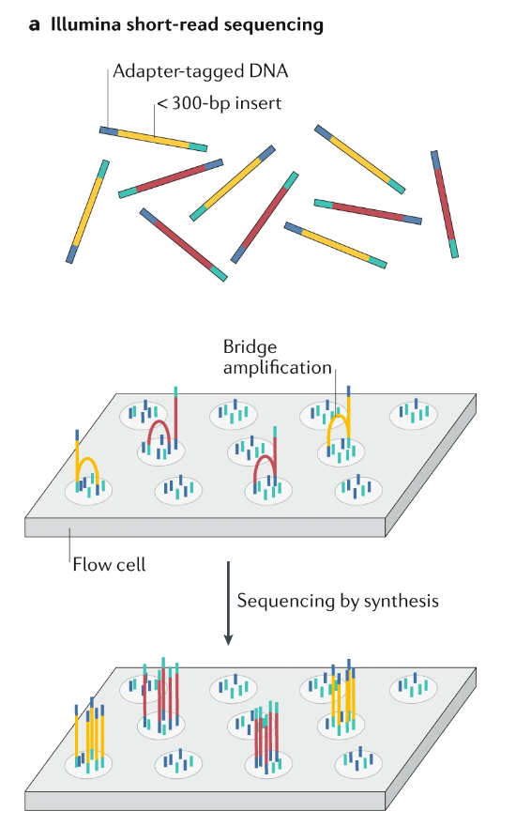
Short read Illumina RNA-seq
and Logsdon GA, Vollger MR, Eichler EE. Long-read human genome sequencing and its applications. Nature Reviews Genetics. 2020 Oct;21(10):597-614.

Slide 58
Transcript
Transcripts are sequences of exons after the introns are spliced out: genome exon1 exon2 exon3 transcript exon1 exon2 exon3
UTRs are UnTRanslated sequences before and after the protein coding region
Protein CoDing Sequence (CDS) starts with a start codon (ATG) and ends with a stop (TAG, TAA, or TGA) for eukaryotic genomes
ATG…
…TAA
3’ UTR
3’ UTR
5’ UTR
ATG…
…TAA
3’ UTR
3’ UTR

Slide 59
Gene
Gene is a locus on the genome containing one or more transcripts
Multiple transcripts per gene are possible due to alternative splicing
Gene starts at the start of the leftmost transcript and ends at the end of the rightmost transcript. All transcripts in a gene are on the same strand
Gene 1
intron1
intron2
exon1
GT
AG
exon2
GT
AG
exon3
Transcript 1
intron3
exon1
GT
AG
exon4
Transcript 2

Slide 60
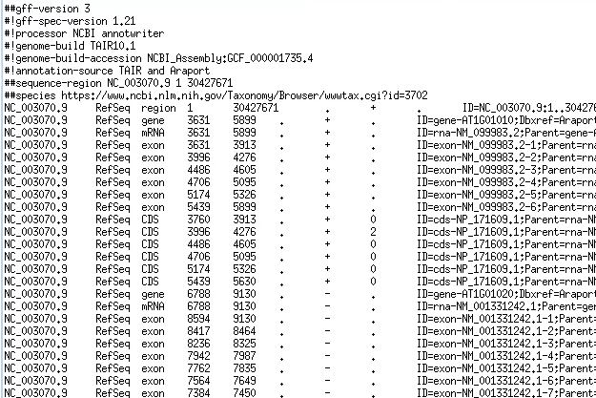
GFF/GTF files provide a map for all known genome features
Column | Description
Seqname | Name of chromosome, scaffold or contig
Source | Name of the datasource
Feature | Feature type (e.g. gene, exon, transcript, CDS, five_prime_UTR)
Start | Start position of the feature
End | End position of the feature
Empty | ‘.’
Strand | Defined as + (forward) or - (reverse)
Frame | Either ‘0’, ‘1’, or ‘2’ - indicating reading frame by base position
Attribute | A semicolon separated list of other info about the feature
GFF has many versions, but the two most popular are:
GTF2 (Gene Transfer Format): https://mblab.wustl.edu/GTF2.html
GFF3 (Generic Feature Format): https://github.com/The-Sequence-Ontology/Specifications/blob/master/gff3.md

Slide 61
Gene representation
gene
transcript or mRNA
…
transcript or mRNA
exon
exon
exon
exon
exon
5’ UTR
5’ UTR
5’UTR
CDS
CDS
CDS
3’ UTR
Start codon (ATG)
Stop codon (TAA,TAG,TGA)

Slide 62
Spliced alignment
We find transcripts on the genome by spliced alignment of transcriptome reads

Slide 63
Variant Calling
Sequencing: A DNA sample is sequenced to generate a large number of short reads containing genetic information.
Alignment: The generated short reads are aligned (mapped) to a known reference genome.
Variant Identification: Bioinformatic algorithms compare the aligned reads to the reference to identify positions where they differ, indicating a variant.
Variant Call Formatting: The identified variants are compiled into a standardized Variant Call Format (VCF) file.

Slide 64
Types of variants
Single Nucleotide Variants (SNVs): A change in a single DNA base pair, such as a single nucleotide polymorphism (SNP).
Insertions/Deletions (Indels): Short segments of DNA that are inserted or deleted.
Structural Variants (SVs): Larger-scale changes to the genome, including deletions, duplications, inversions, and translocations.

Slide 65
Why variant calling is important
Disease Research: Variant calling helps identify genetic mutations associated with various diseases, including cancer.
Clinical Diagnostics: It provides data for diagnosing genetic conditions and understanding individual predispositions to common health problems.
Evolutionary Studies: Comparing variants across populations helps researchers understand evolutionary relationships and genetic diversity.

